Slide 1
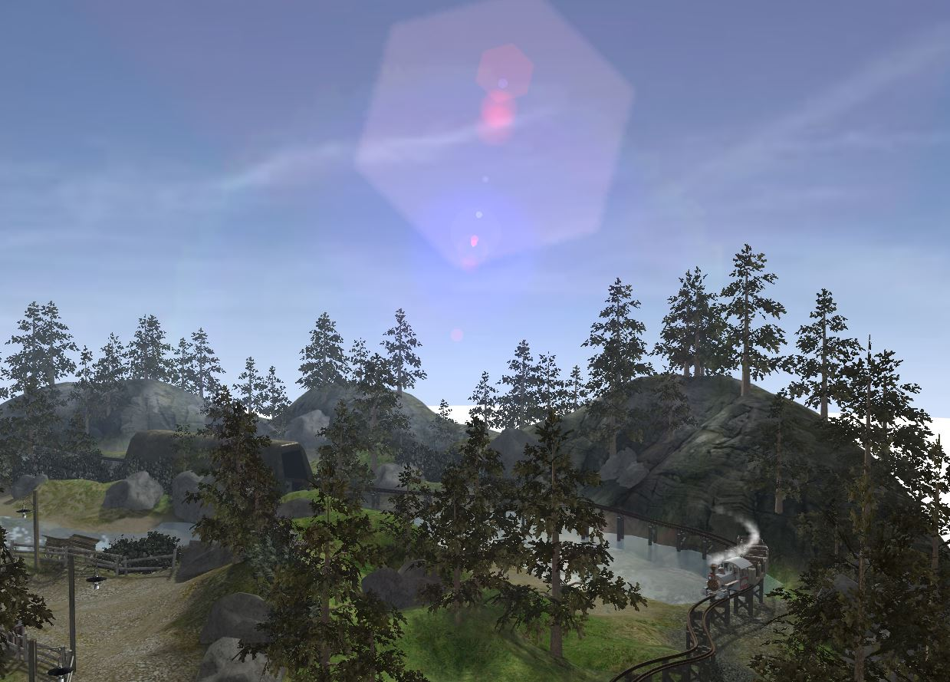
BABYLON.JS
WebGL made easy

Slide 2

DAVIDCATUHE
Senior Program Manager – IE / Open Web Standards Developer Experience and Evangelism
davca@microsoft.com - @deltakosh - http://aka.ms/davca

Slide 3
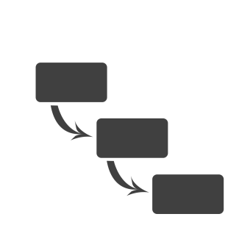
FIRST CONTACT
Hello world Babylon.js
Notes:
Step 0 – step 4

Slide 4
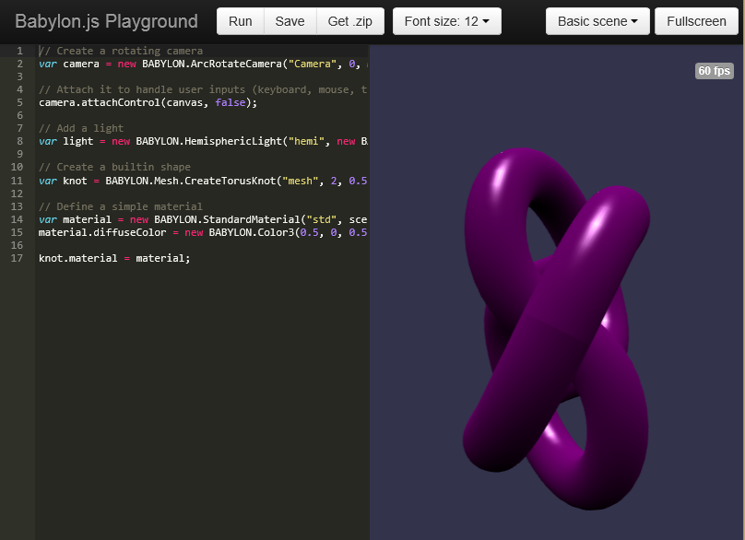
LEARN AND EXPERIMENT
Playground
Notes:
Select code from Playground and copy/paste to previous page

Slide 5
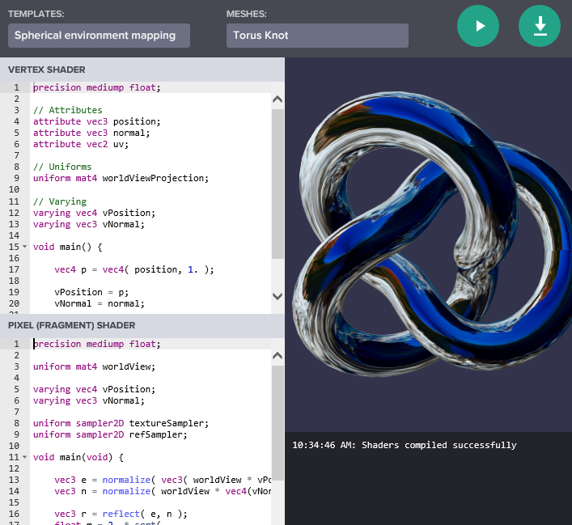
CREATE YOUR OWN SHADER
CYOS
Notes:
Step 5

Slide 6
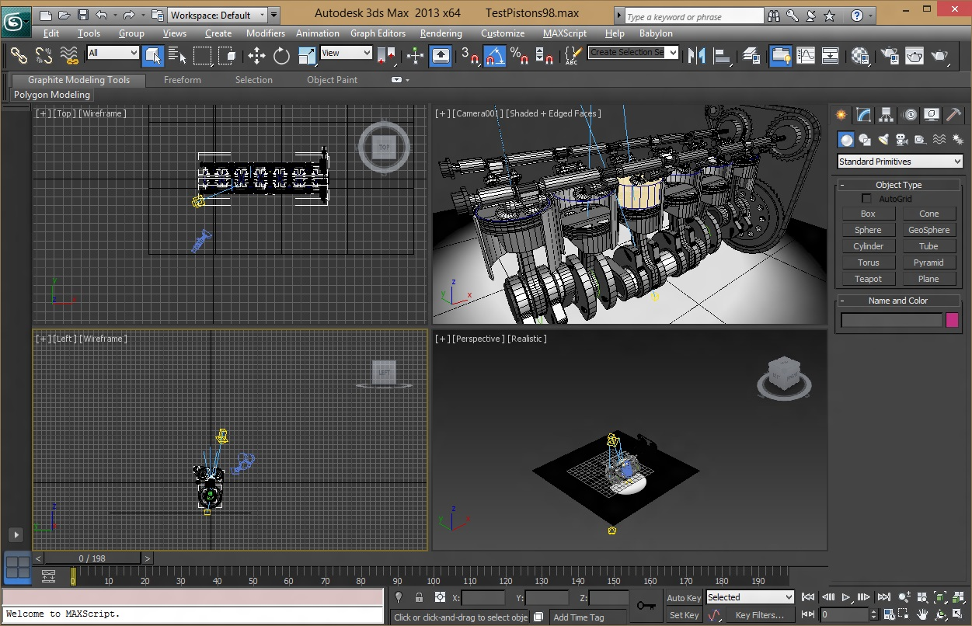
CREATING ASSETS
Using 3dsmax
Notes:
Engine demo
Step 6 / 7

Slide 7






PLAYING WITH INPUT
Touch
Device Orientation
Virtual Joysticks
Anaglyph
Oculus
Gamepad
Camera based on pointer events
Camera based on Device Orientation API
Using pointer events, this camera generates two joysticks on top of the scene
Use this camera with Red/Green glasses
Control camera orientation with Oculus Rift device
Use your gamepad to control your camera
Notes:
Exemple de cameras
Step 8 – 1
Step 8 - 2

Slide 8
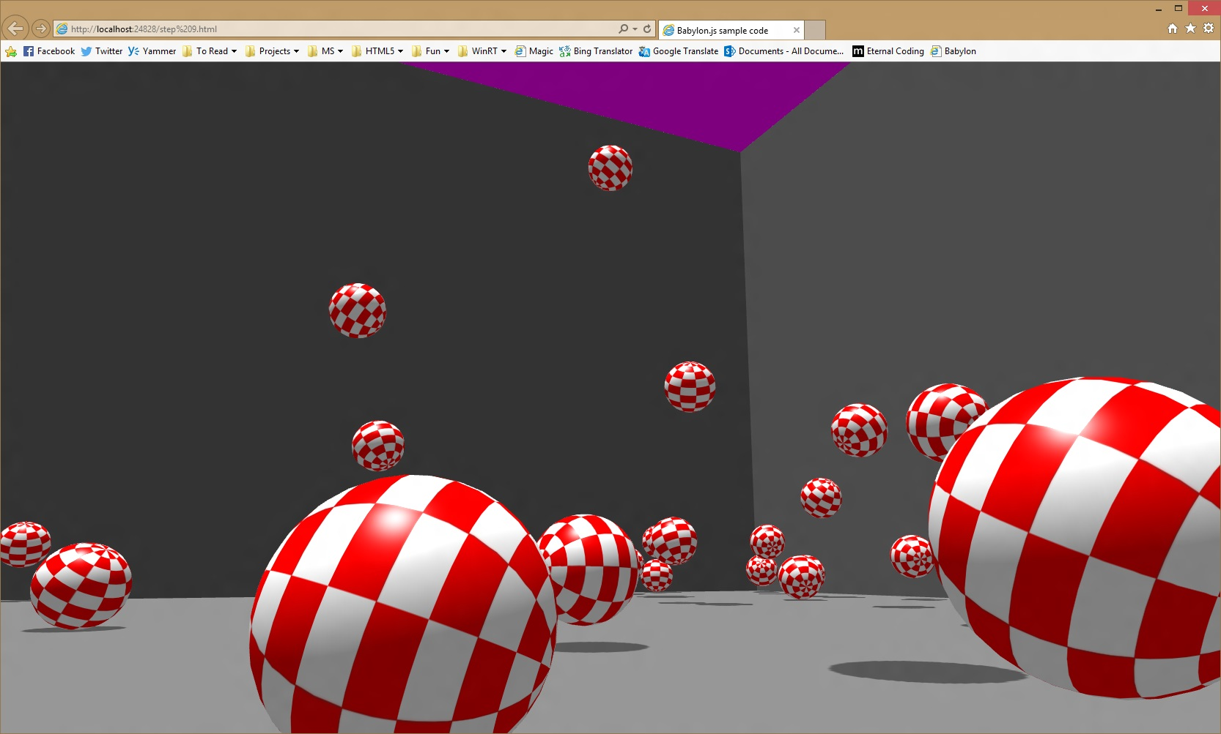
COLLISIONS & PHYSICS
Notes:
Step 9
http://www.babylonjs.com/playground/?9

Slide 9
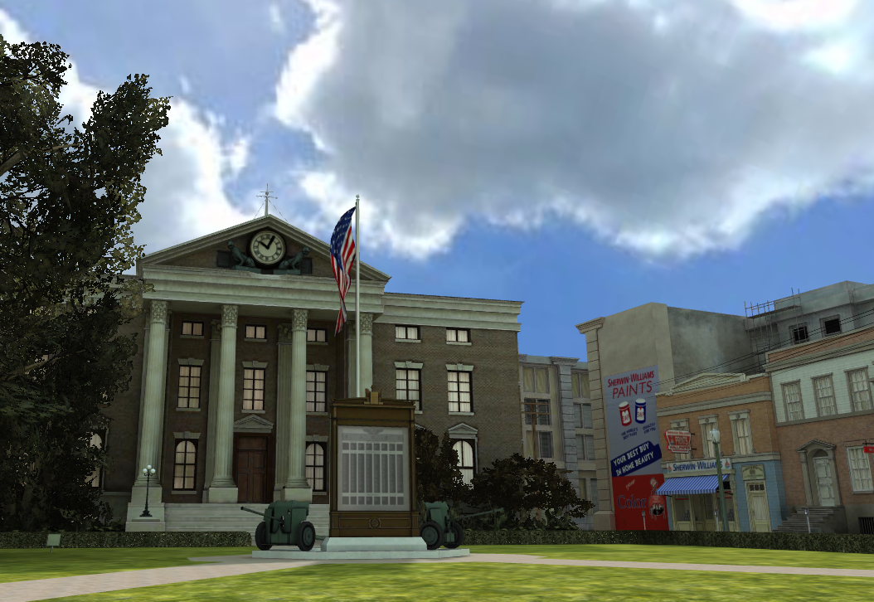
USEFUL LINKS
http://www.babylonjs.com
http://www.babylonjs.com/playground
http://www.babylonjs.com/cyos
https://github.com/BabylonJS/Babylon.js/wiki
http://www.html5gamedevs.com/forum/16-babylonjs

Slide 10
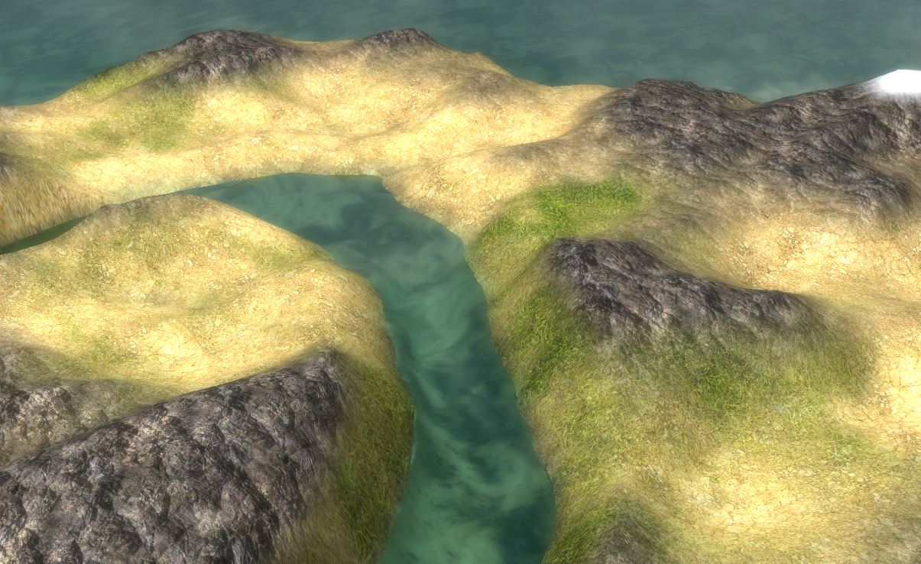
THANK YOU!

